Slide 1
Chapter Nine
Class and Objects, unit testing

Slide 2
Object-Oriented Programming
Up to this chapter we’ve written code using structured programming.
Breaking tasks into functions so the program is easier to maintain and code can be re-used.
We now move to object oriented programming.
Data and functions are grouped together into classes that model the “real world” entities that our code works with.
Each class has its own set of data and a set of methods that act upon the data.
The Python data types that we’ve worked with are all classes. They store data and have methods to access the data.
Example of the list class with the method pop:
And of the string class with the method upper:
["Hello", "World"].pop()
# returns "World"
["Hello", "World"][0].upper()
# returns "HELLO"

Slide 3
Example: a Simple User-Defined Class
A user-defined class is a class that the programmer defines, which is different from a class like the list class that is a Python built-in class.
Suppose we have a user-defined class called Counter: A class that models a mechanical device to count the number of people at an event.
What are the tasks of the Counter class?
Keep track of the count
Show the count
To use the Counter class, we first instantiate or create an object from the class:
When we use the name of the class as a function, such as Counter(), Python will create an object of the class Counter and pass back a reference to the object.
We store the reference of the Counter object in a variable named tally.
tally = Counter() # Creates an object or instance

Slide 4
Example: Using a User-Defined Class
After we create the Counter object, we can call the methods of the object to do work with the object.
Each method name is prepended with the name of the object, much like how we call methods of a built-in Python class.
The methods above work with the internal count data, which is stored in the object.
tally.reset() # set the count to 0
tally.click() # increment the count
tally.click() # increment the count
result = tally.getValue() # return the count, # result is 2
tally.click() # increment the count
result = tally.getValue() # return the count, # result is 3

Slide 5
Defining a Class

Slide 6
Class Definition
To implement a class, we define the class so that Python will recognize it as a new data type.
A class definition is typically coded in its own module (file). The user of the class will import it in order to use it.
Define a class with the keyword class and the class name, which starts with an uppercase letter
class ClassName:
""" docstring to explain the purpose of the class """
def method1(self, other input arguments) : """ docstring for method1 """
# code for method1
def method2(self, other input arguments) : """ docstring for method2 """
# code for method2
Define all methods for the class
Don’t forget docstrings!
Note indentation

Slide 7
The self Keyword
Each method of a class has a required first input parameter: self
self is a reference to the current object that is running the method.
If a function is defined in the class but doesn’t have self as the first input parameter, it is not considered by Python to be a method of the class. Attempting to call this method from an object will result in an exception.
Even though self is the required first input parameter, when we call a method we ignore the self parameter and don’t need to pass anything to it. Python will fill in the self variable with a reference to the current object at run time.
class ClassName:
""" docstring to explain the purpose of the class """
def method1(self, other input arguments) : """ docstring for method1 """
# code for method1

Slide 8
Example: Class Definition
We have a CashRegister class which keeps track of the number of items that are purchased and the total price for the purchase.
There are many methods in the CashRegister class, only the addItem method is shown as an example.
Note the keyword self is the first input argument for the method, and it is also in front of some of the variables, making them instance variables or instance attributes.
class CashRegister :
""" Cash register keeps track of item count and total price """
def addItem(self, price) :
""" add price to total and increment count """
self._totalPrice += price
self._itemCount += 1

Slide 9
Attributes in a Class

Slide 10
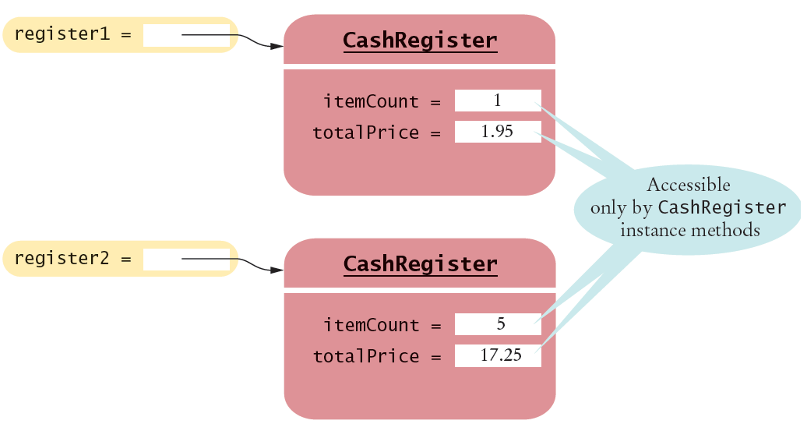
Instance Attributes (1)
An object stores its data in instance attributes, which are variables specific for one object (one instance).
In the example below there are 2 CashRegister objects. Each object has its own instance attributes named itemCount and totalPrice.

Slide 11
Instance Attributes (2)
Instance attributes are part of the implementation details that should be hidden from the user of the class.
In some languages an instance attribute is private data and can only be accessed by calling the methods of the class (or instance methods).
The Python language does not enforce this restriction.
However, the underscore in front of the instance attribute name tells the users of the class that they should not directly access the attribute.
Instance attributes always have the keyword self and the dot operator in front.
The scope of the instance attributes is the same as the scope of the object in which the attributes belong. As long as the object exists, its instance attributes are available.
Instance attributes can be accessed by all instance methods of the class. These attributes don’t need to be passed to a method in order for the method to use them. They act like global variables for the instance methods.

Slide 12
Local Variables
In addition to instance attributes, the methods of a class can create local variables that are specific to each method.
The local variables are available only to the method in which they are defined. When execution returns from a method, the local variables are no longer available.
Local variables in a method are used to store temporary data for the method to do its job. When the method finishes its task, local variables automatically goes out of scope (freeing memory).
Local variables do not have the keyword self in front.
It is important to know when to use instance attributes vs. local variables:
Use instance attributes only for data that need to last as long as the object exists.
Use local variables for all other data.

Slide 13
Example: Attributes and Local Variables
In the CashRegister class definition we have the addItem method
The instance attributes are totalPrice and itemCount.
The keyword self is in front of each name.
The names start with an underscore to show that they should only be accessed by a method of the class.
These attributes need to exist as long as the object exists.
The local variable is price.
It stores the input from the caller of the addItem method.
It doesn’t have the keyword self in front.
This variable is temporary, it is only used by addItem to receive user input.
def addItem(self, price) :
""" add price to total and increment count """
self._totalPrice += price
self._itemCount += 1

Slide 14
Class Attributes
Class attributes belong to the entire class and not to a particular instance.
Many classes don’t need to have class attributes.
A class attribute is typically used to:
Store a constant that all objects of the class can use
Keep track of the number of instances of the class.
Class variables are equivalent to “static variables” in other languages.
Example of a class attribute TAXRATE
class CashRegister :
_TAXRATE = 0.0925 # tax rate is used by all instances # of CashRegister
def addItem(self, price) :
""" add price to total and increment count """
self._totalPrice += price
self._itemCount += 1

Slide 15
Methods in a Class

Slide 16
Instance Methods
Instance methods always have self as the first input argument.
They can access instance variables but the variables don’t have to be passed in as input arguments.
Note that price needs to be passed to addItems because it’s not an instance variable.
But totalPrice and itemCount don’t need to be passed in because they’re instance variables. Instance variables are available to all instance methods.
def addItem(self, price) :
""" add price to total and increment count """
self._totalPrice += price
self._itemCount += 1
Instance variables are used but don’t need to be passed in to the method

Slide 17
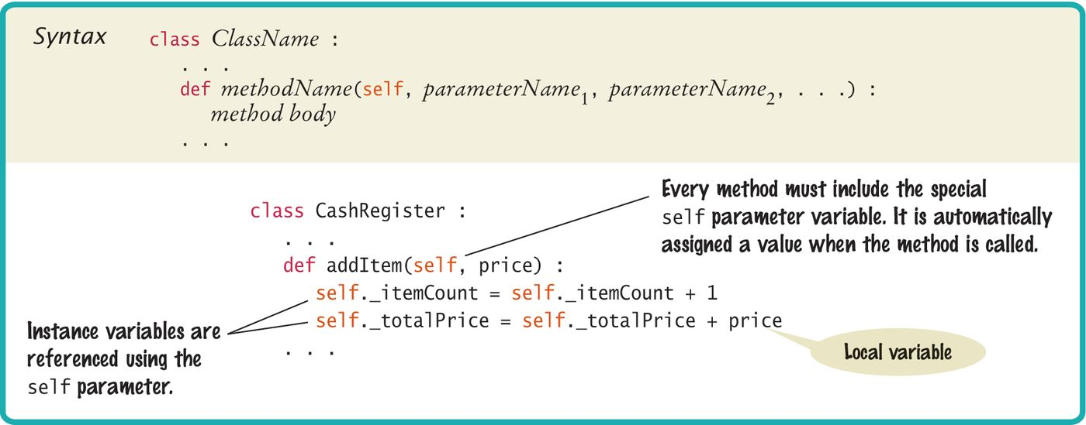
Syntax: Methods
Another view of the addItems method in the CashRegister class.

Slide 18
Private Methods
There are 2 types of methods in a class:
Public methods can be called by functions outside of the class.
Private methods are called only by methods inside the class.
When one method needs to call another method, we use the self keyword to refer to the current object:
Just like with instance variables, private method names start with an underscore.
The underscore shows that they should only be called by other methods of the class, and not by functions outside of the class.
def addItems(self, quantity, price) :
for i in range(quantity) :
self._addItem(price)

Slide 19
Public Interface of a Class (1)
The set of all public methods in a class make up the public interface of the class.
When we work with an object of a class, we don’t need to know how the object stores its data, or how the methods are implemented.
Example: we don’t know how a str object organizes a character sequence, or how a dictionary stores its keys and values.
All we need to know is the public interface –– which methods we can call and what these methods do.
The process of providing a public interface, while hiding the implementation details, is called encapsulation.
If we work with an application that goes through multiple versions over a long period of time, it is common for the implementation details to change, usually to make objects more efficient or more capable.
When the implementation is hidden, the improvements do not affect the users of the objects because the public interface doesn’t change these users.

Slide 20
Public Interface of a Class (2)
When we design a class, we start by specifying the public interface of the new class.
Provide methods for the user to do work with the class
Provide methods for the user to access data stored in the class
Provide methods for the user to modify data stored in the class

Slide 21
Accessor and Mutator Methods
Some of the public methods fall into two categories:
1) Accessor Methods or 'get' methods
Lets the user view a data value but not modify it
Returns a reference or a copy to the data
Example from the CashRegister class:
def getTotal(self): # return the totalPrice
def getCount(self): # return the itemCount
2) Mutator Methods or ‘ set' methods
Changes data values in the object
Usually takes a parameter that will change an instance variable
Example from the CashRegister class:
def addItem(self, price): # add price to totalPrice
def clear(self): # zero out the totalPrice # and the itemCount

Slide 22
Special Methods: Constructors

Slide 23
Special Methods
Some methods in a class are called special methods or magic methods
These methods are run by Python without us directly calling them. They run as if by magic.
The special method names begin and end with 2 underscores.
The special methods are run by Python based on the context of the code that’s working with the object.
Example:
One common special method is a constructor. Its task is to create or construct an instance of the class.
The constructor name for any class is: _ _init_ _
But we don’t call the method _ _init_ _ directly. To create an instance of a class, recall that we use the syntax:
Based on the context in the code, which is a call to ClassName(), Python will call _ _init_ _ for us.
varName = ClassName()

Slide 24
Constructor
A constructor is a method that constructs or creates instance of an object.
The tasks of the constructor:
Accept 1 or more input parameters, self is the first parameter.
Initialize all instance variables of the object with the input arguments or with default values.
The constructor has the special name _ _init_ _ because its purpose is to initialize an instance of the class.
Example: constructor of the CashRegister class
self keyword is first parameter
def _ _init_ _(self) :
self._itemCount = 0
self._totalPrice = 0
Initialize instance variables

Slide 25
Making Constructors Flexible
There is only one constructor per class.
But a constructor can have default argument values to give the user different ways to create objects of the class.
We take advantage of named or keyword arguments and default values:
def _ _init_ _(self, discount = 0.0) :
self._itemCount = 0
self._totalPrice = 0
self._discount = discount
There are now 2 ways to instantiate an object of the CashRegister class:
When the customer has no discount
When the customer has a 10% discount
transaction1 = CashRegister() # discount is 0.0
transaction2 = CashRegister(0.10) # discount is 0.10

Slide 26

Programming Tip
Instance variables should only be defined in the constructor.
There is nothing to prevent us from creating instance variables in any other method of a class.
But since the constructor is run before any other method can be called, instance variables that are created in the constructor are sure to be available for all methods.

Slide 27
Other Special Methods

Slide 28
Special Method: _ _repr_ _
In addition to the constructor, another common special method is the _ _repr_ _ method, which returns data, typically a string, to represent the object.
Example: the CashRegister object can return a string of the total price
Whenever the object is used in string context, Python will run the _ _repr_ _ method to convert the object into a string.
transaction1 is a CashRegister object.
The print function needs a string as input argument.
Therefore Python runs the _ _repr_ _ method to get the returned string so that it can be printed.
def _ _repr_ _(self) :
return "Total price: " + str(self._totalPrice)
print(transaction1)
# output: Total price: 35.00

Slide 29
Special Method: Operator Overloading
Many of the special methods are operator overloading methods: they run whenever the objects are used with operators.
Example:
We have a class called Sample, which has the _ _mul_ _ method for multiplying.
Suppose we have 2 Sample objects named s1 and s2, and we code:
s1 * s2
The Python interpreter recognizes that * is the multiply operator. Python knows how to multiply 2 numbers but it doesn’t know how to multiply 2 Sample objects.
Python will look up the Sample class for an implementation of the _ _mul_ _ method.
If the method doesn’t exist, then an exception is raised.
If the method exists, then _ _mul_ _ is run.
It is up to us to write the _ _mul_ _ method to tell Python how to multiply 2 Sample objects.

Slide 30
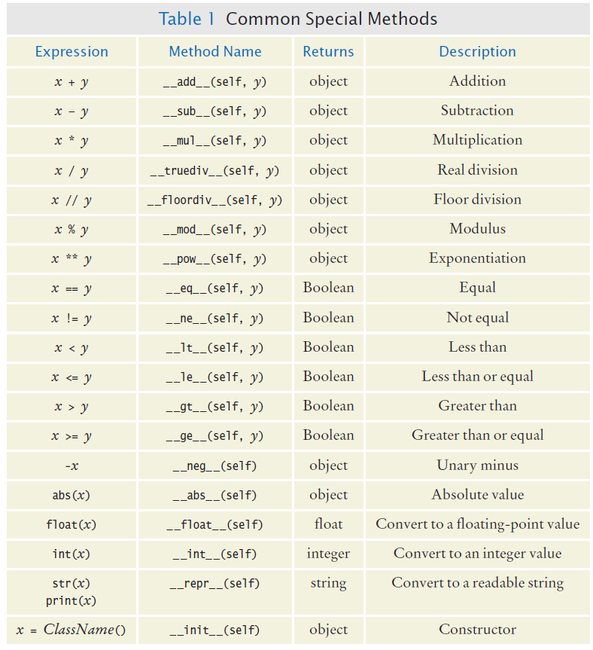
Common Special Methods

Slide 31
Common Special Methods

Slide 32
Example: Fraction Class

Slide 33
Writing a Fraction Class
Suppose we want to have a Fraction class to represent fractions such as 7/8.
For the fraction 7/8, the numerator is 7 and the denominator is 8. The denominator cannot be 0.
Requirements for the Fraction class:
Instance variables: numerator and denominator are valid and simplified, the sign of the fraction must be stored.
Support arithmetic operators with fractions.
Support relational operators for comparing fractions.
Have a string version of the format so that the fraction can be expressed as a string: “numerator / denominator”
Have a conversion to an equivalent decimal value.
Be immutable.

Slide 34
Requirement 1: Constructor (1)
The constructor should accept a numerator value and denominator value as input parameters.
The numerator parameter can default to 0, and denominator parameter can default to 1.
We need to check that the denominator value is not zero. If it is, we raise an exception and don’t continue the constructor. This way we will never create a Fraction object with illegal data.
We need to keep track of the sign of the fraction in an instance variable.
We also need to simplify the fraction: 2/4 should be simplified to 1/2.
Lastly, we store the simplified numerator and denominator values into instance variables.

Slide 35
Requirement 1 : Constructor (2)
def _ _init_ _(self, numerator = 0, denominator = 1) :
if denominator == 0 : # stop if denominator is 0
raise ZeroDivisionError("Denominator can’t be zero.")
if numerator == 0 : # fraction is 0, done
self._numerator = 0
self._denominator = 1
else : # store the sign
if numerator < 0 and denominator > 0 or
numerator > 0 and denominator < 0) :
self._sign = -1
else :
self._sign = 1
# and save absolute values
self._numerator = abs(numerator)
self._denominator = abs(denominator)
# simplify fraction with a private method
self._simplify()

Slide 36
Private Method : _simplify
def _simplify(self):
a = self._numerator
b = self._denominator
# loop to find GCD
while b :
a, b = b, a%b
# a is GCD
if a != 1 : # need to simplify fraction
self._numerator //= a
self._denominator //= a
# else done, fraction is already simplified

Slide 37
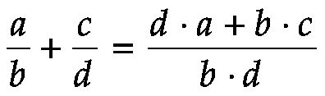
Requirement 2: Add Method (1)
Here we use the add method as an example, the other arithmetic operators (subtract, multiply, divide) work the same way.
All of the arithmetic operations that can work on a Fraction object should return the result in a new Fraction object.
For example, when the statement below is executed, frac1 should be added with frac2 and the result returned as a new Fraction object that is assigned to the sumFrac variable:
Two fractions must have a common denominator for adding. If they do not have a common denominator, the general formula to add 2 fractions is:
sumFrac = frac1 + frac2

Slide 38
Requirement 2: Add Method (2)
We use the special method _ _add_ _ to implement the + operator.
The first input parameter self refers to the object on the left side of the + operator.
The object on the right side of the + operator is referenced by the 2nd input argument rhs (for right hand side).
def _ _add_ _(self, rhs) :
# calculate resulting numerator
n = (self._numerator * rhs._denominator +
self._denominator * rhs._numerator)
# calculate resulting denominator
d = self._denominator * rhs._denominator
# create the resulting Fraction object to return
return Fraction(n, d)
self
rhs
sumFrac = frac1 + frac2

Slide 39
Requirement 3: Comparing Fractions
There is a set of relational operators (<, <=, >, >=, ==, !=) that are used to compare numbers.
To make our Fraction class user-friendly, we also want these relational operators to work with our Fraction objects.
We use special methods to override these operators.
Here we have the == operator overloading as an example, but other relational operators work the same way.
The special method for == is _ _eq_ _
Using the == operator
def _ _eq_ _(self, rhs) :
return (self._numerator == rhs._numerator and
self._denominator == rhs._denominator)
# a boolean is returned for relational operators
if frac1 == frac2 : # Python runs _ _eq_ _
print("The fractions are equal.")

Slide 40
Requirement 4: String Representation
Most classes should have a string representation so that the object can be used in context of a string.
Recall that the special method to convert an object to a string is _ _repr_ _
Example of converting a Fraction object to a string
def _ _repr_ _(self) :
return str(self._numerator) + "/" + str(self._denominator)
print("The fraction is", str(frac1)) # Python runs _ _repr_ _
# output: The fraction is 1/2

Slide 41
Requirement 5: Decimal Representation
Just as with the string representation, a fraction is commonly used in its decimal or floating point format.
To make our Fraction more user friendly, we use a special method to convert a Fraction object to a floating point format so the user can easily do the following:
The special method _ _float_ _ is used to convert a Fraction object to its equivalent floating point number.
floatNum = float(frac1)
def _ _float_ _ (self) :
return self._numerator / self._denominator

Slide 42
Requirement 6: Immutable Fractions
Recall that users of the Fraction class should only access public methods of the class.
If we don’t provide any public method (other than the constructor) that can change the instance variables _numerator, _denominator, and _sign, then the Fraction object will remain immutable.
This means:
We don’t write set methods or mutators that let the user change the instance variables.
For arithmetic operators, we return a new object and don’t modify the current objects.
To encourage the users to only use public methods, we make sure to use Python standard practice when naming variables and methods:
Instance variable names start with underscore
Private method names start with underscore
Public method names are descriptive, and all public methods have a docstring to help the user use the class correctly.

Slide 43
Unit Testing of a Class

Slide 44
A Class as a Module
When we write a class we expect that the class may become a part of a larger program.
This is why we put the class definition in a separate module (file), where the filename is typically the class name but in lowercase.
Example, the CashRegister class definition can be in a module called cashRegister.py
When a program needs to work with the CashRegister class, it needs to import the class
Note that the filename is cashRegister.py, but the from statement refers only to cashRegister (no .py extension).
from cashRegister import CashRegister

Slide 45
Unit Testing a Class
As we write a class definition, we need to test each method that we code.
To write the test cases for the methods of a class, at the end of the source file we write a block of code which serves as the test driver for our class.
A test driver is a block of code that calls each method in the class at least once so we can verify that each method works as expected.
When we run the source file that has our class definition:
The class definition doesn’t run. It is simply our instructions for Python on how a particular object would behave.
It is the test driver that runs the methods (drives the methods)
Testing a class with its test driver is called unit testing.
A class should always be unit tested first before it is integrated into a larger program.

Slide 46
Test Driver Plan
When writing test driver code we need to think about the public interface of the class:
All public methods should be called at least once
If the objects of the same class will interact (such as adding 2 Fraction objects) then we need to create more than one object.
Initialize each object with various values: small and large
When printing out the result, print the expected value along with the program output value so it’s easy to check.
Planning the test driver is an important step because it helps us understand how our object should behave. This can help us track down errors at an early stage, which is when debugging is simpler.

Slide 47
Reference to an Object

Slide 48
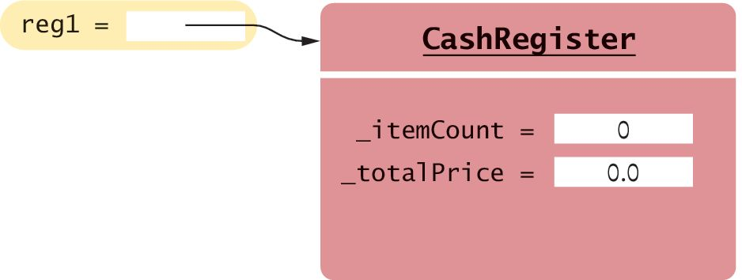
Object References
When an object is created, it takes up memory and resides in a particular memory location.
When we assign the object a variable name, the name is a reference to the memory location where the object is.
reg1 = CashRegister
Reference
The constructor returns a reference to the new object, and that reference is stored in the reg1 variable.
Object

Slide 49
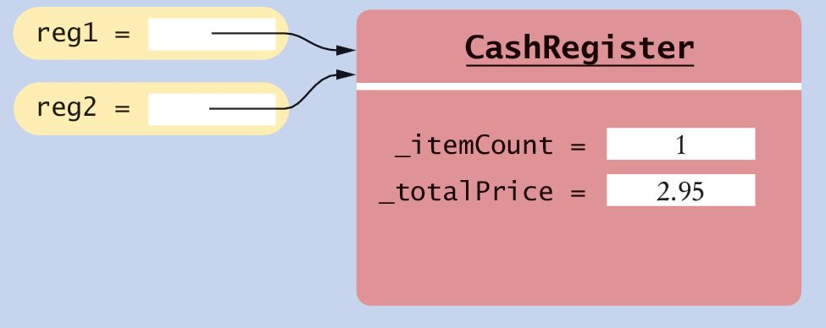
Shared Reference or Alias
When we assign an object name to another variable, we create an alias to the existing object.
The object now has 2 shared references.
Single Reference
It is this shared reference or alias that makes it seem as if an “object” is passed to a function or method.
In reality, the caller passes the name or reference of the object to the called function (callee). The callee now has an alias to the object and can do work with the object.
The object can be accessed by the callee and the caller in the exact same way.
reg1 = CashRegister()
Shared References
reg2 = reg1

Slide 50
Review: Testing if References are Aliases
To check if references to objects are aliases, use the is operator:
# reg1 and reg2 are references to CashRegister objects
if reg1 is reg2 :
print("reg1, reg2 are aliases to the same object.")
if reg1 is not reg2 :
print("reg1, reg2 refer to different objects.")
Contrast the test above with the following, which checks if the data in the objects are equal :
if reg1 == reg2 :
print("reg1, reg2 contain the same data.")

Slide 51
The None reference
A reference may point to no object, in which case it has the value None.
If we invoke methods of an object when the reference is None, we will get an exception.
To test if a reference is None before using it:
The None reference is useful for a function or method to signal that an object is not returned, due to an error or some condition.
The caller can test for the existence of the object before doing work with it.
reg = None
print(reg.getTotal()) # Causes a runtime error!
if reg is not None # CashRegister object exists
print(reg.getTotal())

Slide 52
The self Reference
We’ve seen that the self reference is used to refer to the current object:
The self reference can also be passed as an input argument.
Suppose we have a Person class with a method: likes(self, other) that checks, perhaps from a social network, whether a person likes another person and returns a boolean.
We can write a method to check whether the 2 persons are friends with each other
def addItem(self, price) :
self._totalPrice += price
self._itemCount += 1
def isFriend(self, other) :
return self.likes(other) and other.likes(self)
Current Person likes other Person?
Other Person likes current Person?

Slide 53
Object Clean Up
The object and all of its instance variables stay in memory and is available as long as there is at least one reference to it.
When an object has no reference at all, then it is no longer accessible and eventually is removed by a part of the virtual machine called the “garbage collector.”
Garbage collection runs whenever Python runs, so we can create objects without worrying about memory leaks.
The garbage collector doesn’t necessarily free the unreferenced objects from memory as soon as the last reference is removed, but it runs efficiently enough for all but extreme memory sensitive cases.
reg1 = CashRegister() # New object referenced by reg1
reg1 = CashRegister()
# Another object created, referenced by reg1
# First object will be garbage collected

Slide 54
End of Chapter 9 Notes

